Slide 1
Final Presentation
Team 8
Ze An
Priyanka Anantha
De-Wei Chang
Andria Nyenhuis
Tong Shen

Slide 2
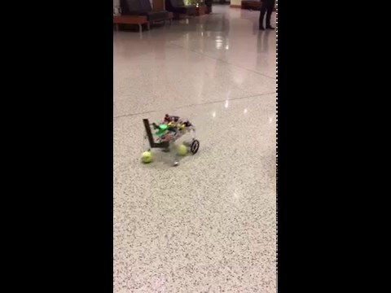
FSM
Design
Robot
Validation
START
Ball Searching
ball found
ball_count< 3
Ball Tracking
ball y > ball_y_threshold
Ball Collecting
container_signal=0
ball_count = 3
Container Searching
container_signal=1
Container Tracking
size >= container_threshold
Ball Dispensing
size < container_threshold

Slide 3
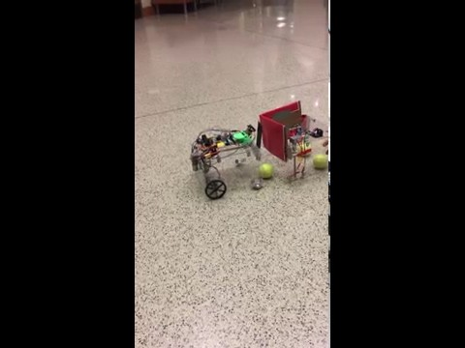
Flow Chart
Design
Ball Dispensing
Validation
START
front_switch=0
Stop robot motor
Open trap door
Push plate forward
front_switch=1
Stop robot motor
count=500
Move robot back
Stop push plate
count<500
Close trap door
Move robot forward
count=500
Stop robot motor
count<500
back_switch=0
Stop push plater
back_switch=1
Push plate back
Signal container

Slide 4
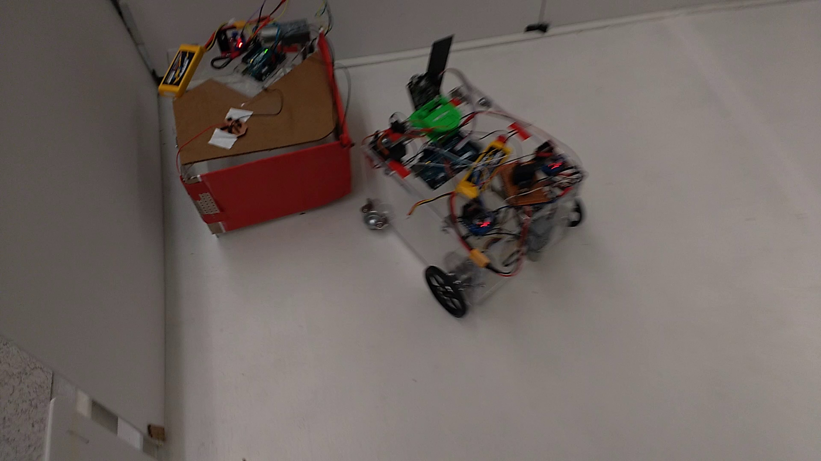
FSM
Container
Design
Validation
START
Bottom switch = 0
Stop motor
Bottom switch = 1
Sensor on
Top switch = 0
Motor forward on
Top switch = 1
Stop motor
Sensor off
Motor reverse on
Sensor on

Slide 5
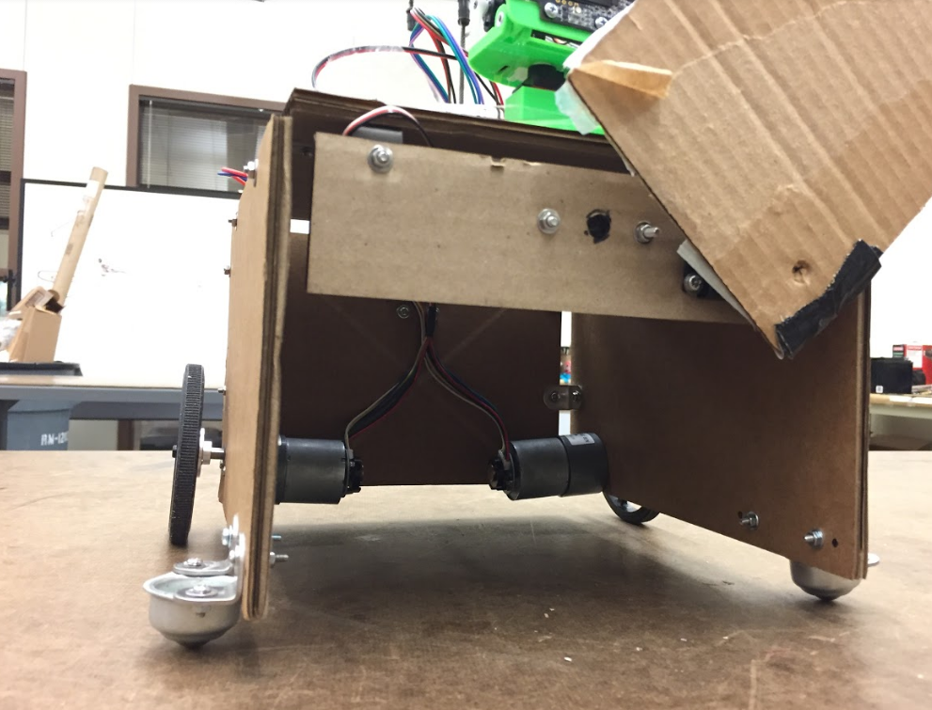
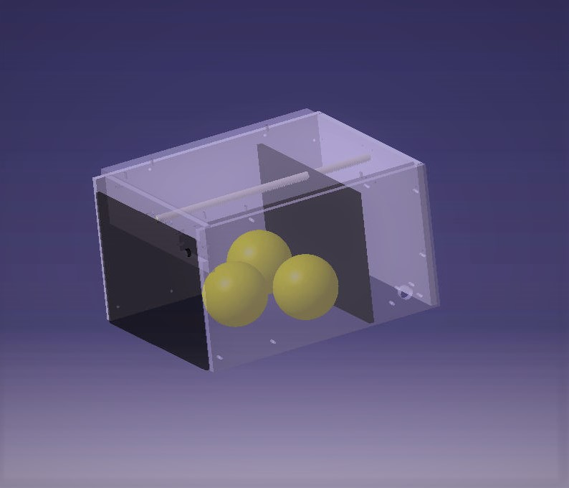
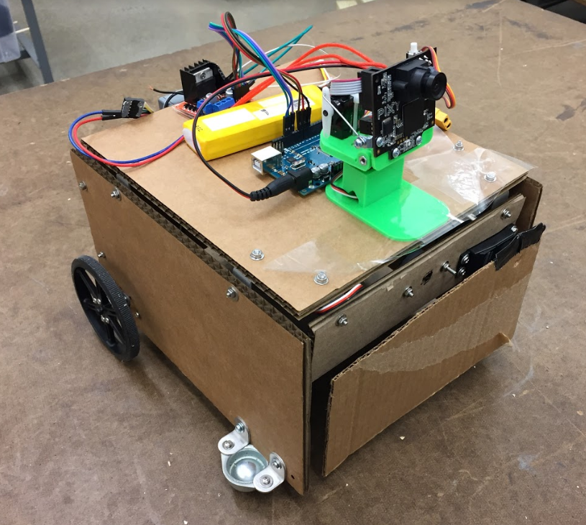
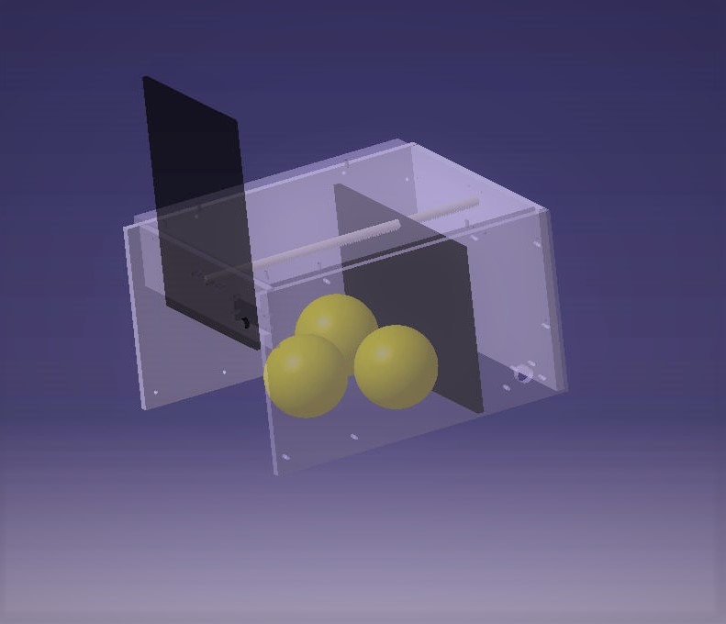
Door Closed
Door Open

Slide 6
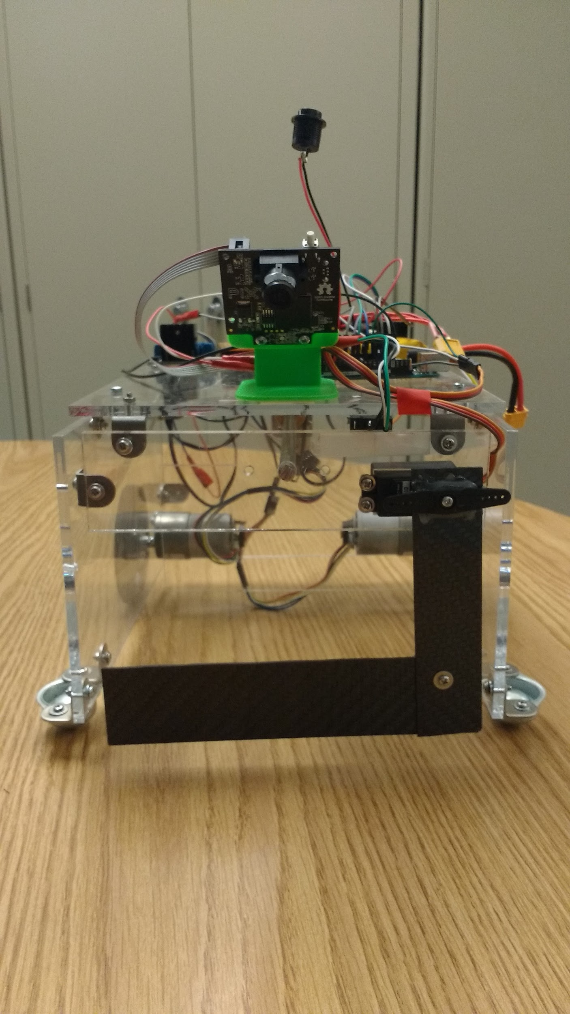
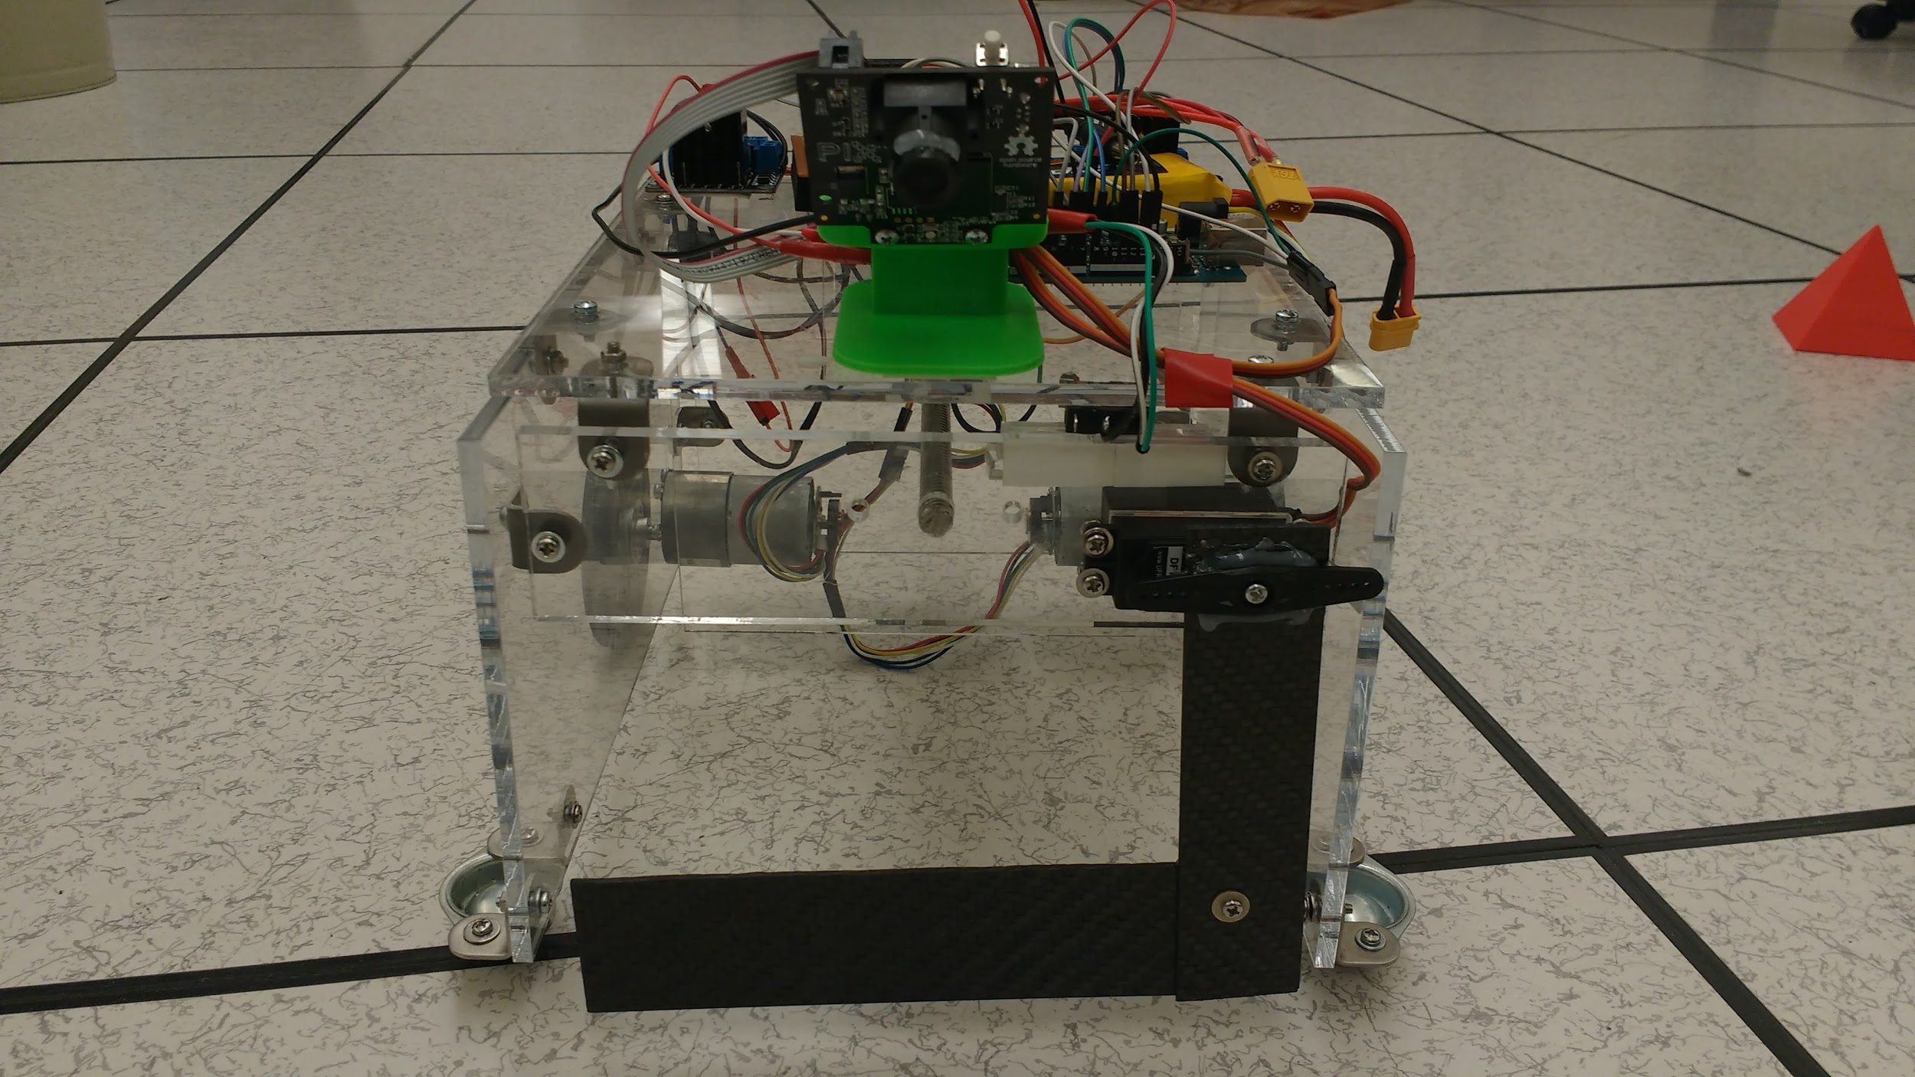
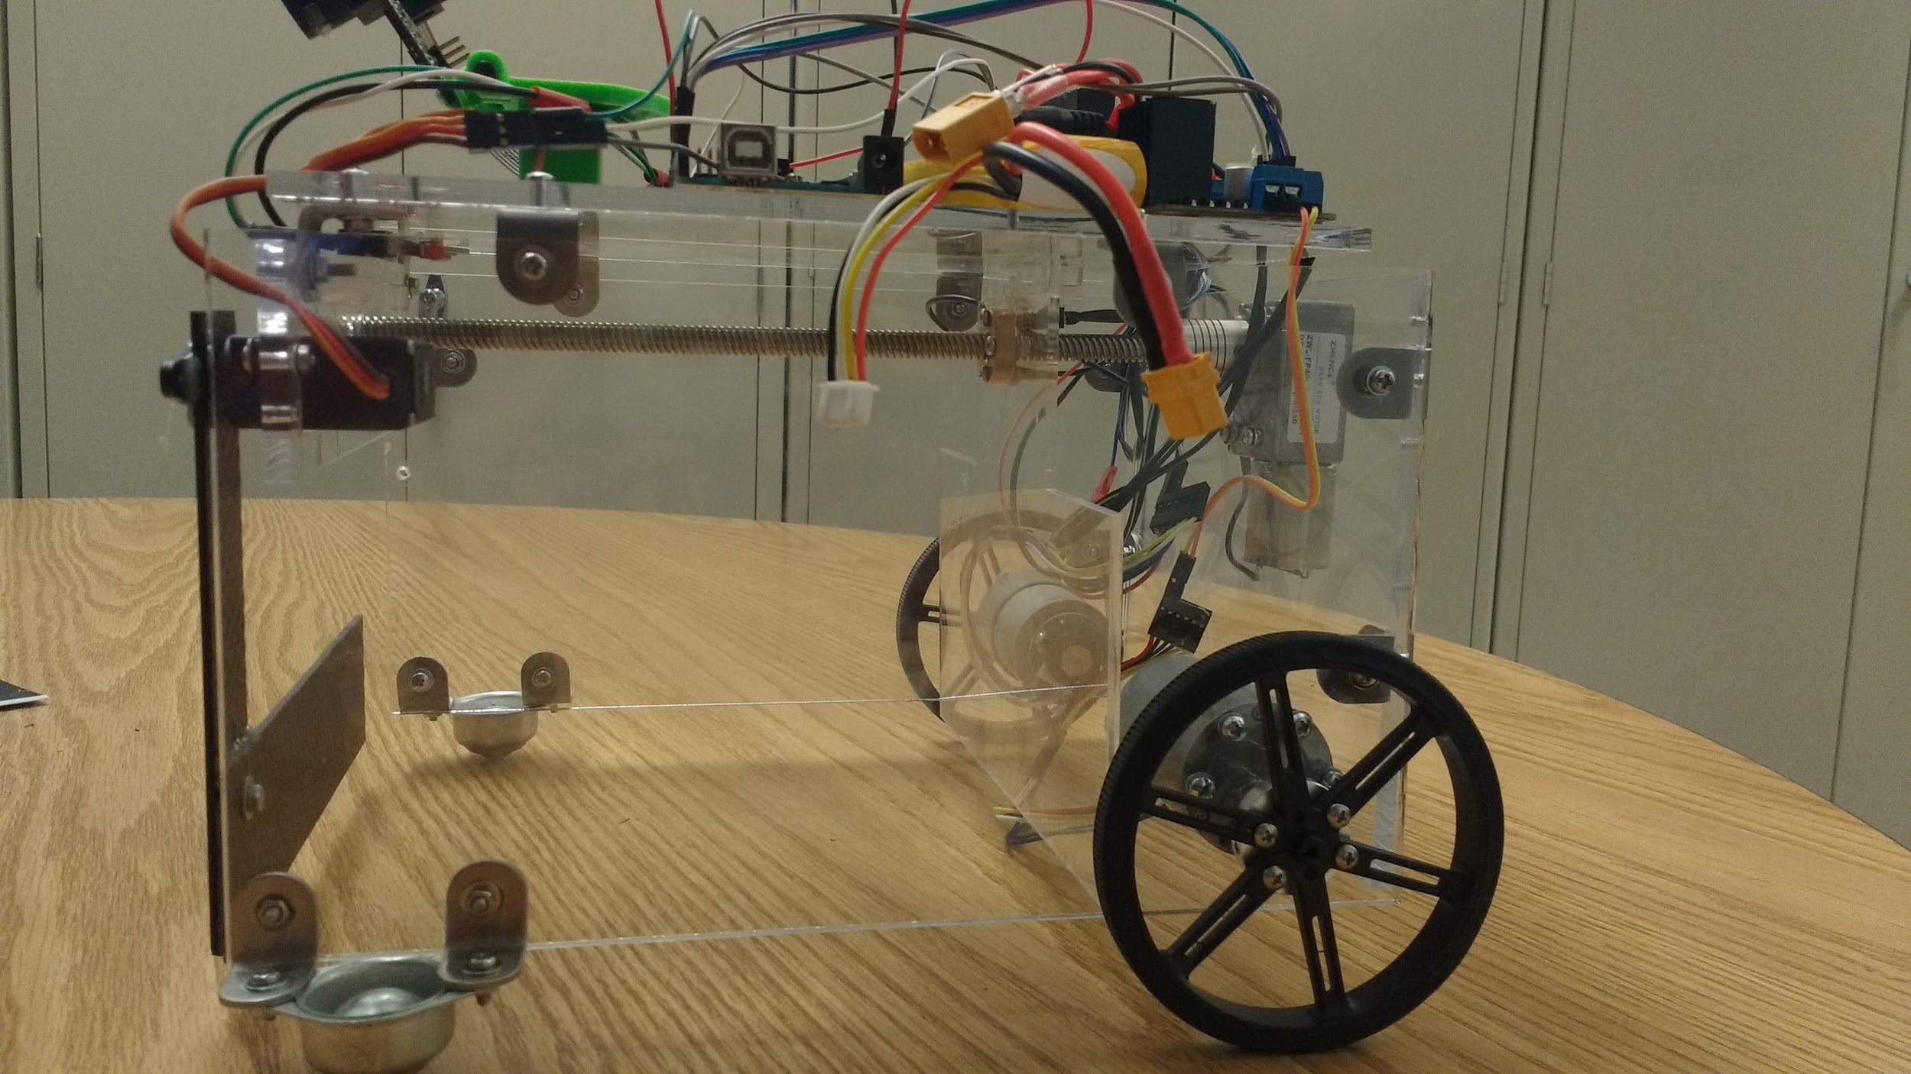
Robot Design
Design Validation

Slide 7
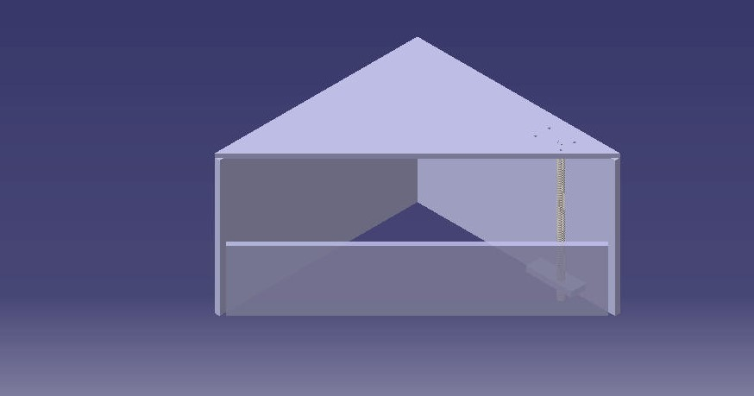
Container Design

Slide 8
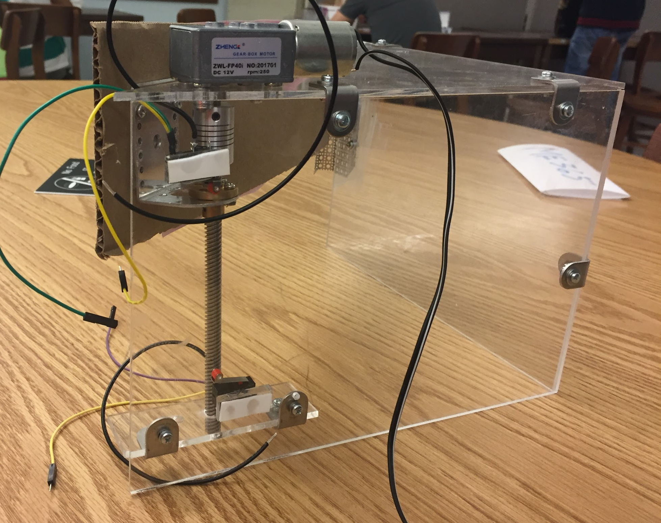
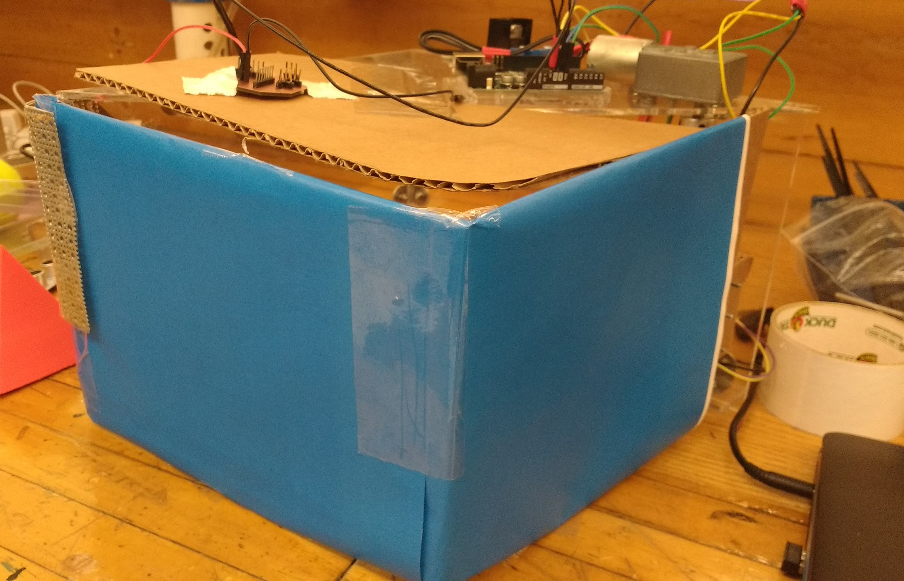
Container Design

Slide 9
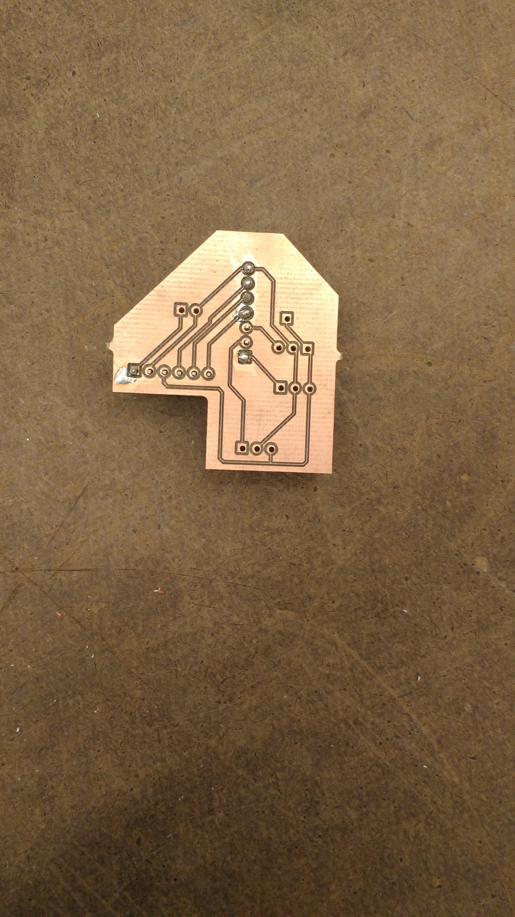
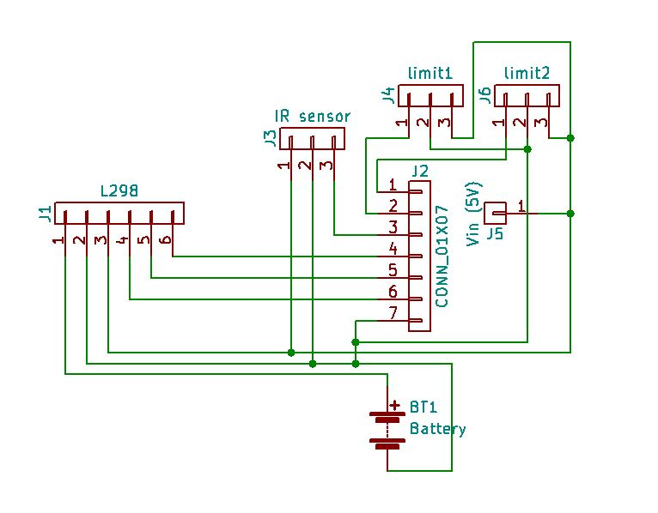
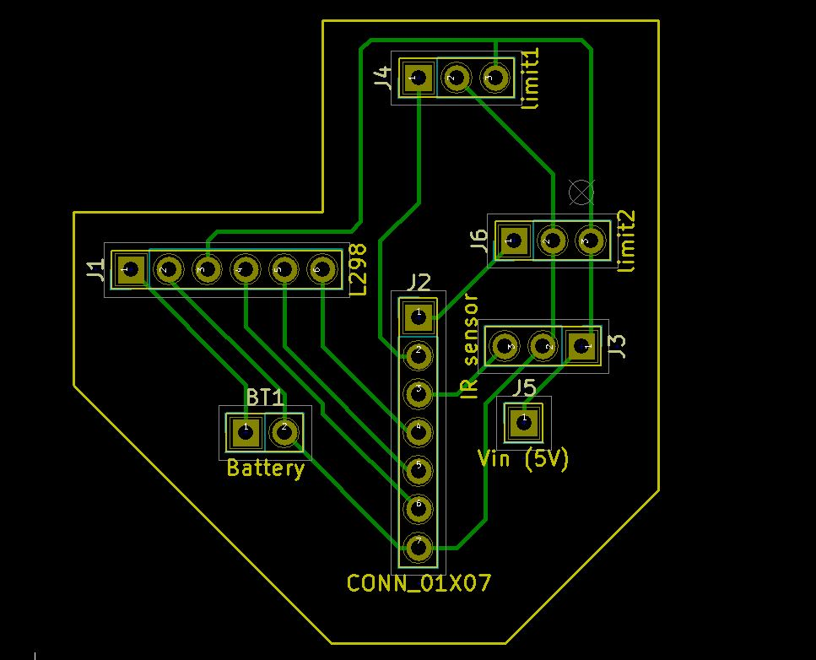
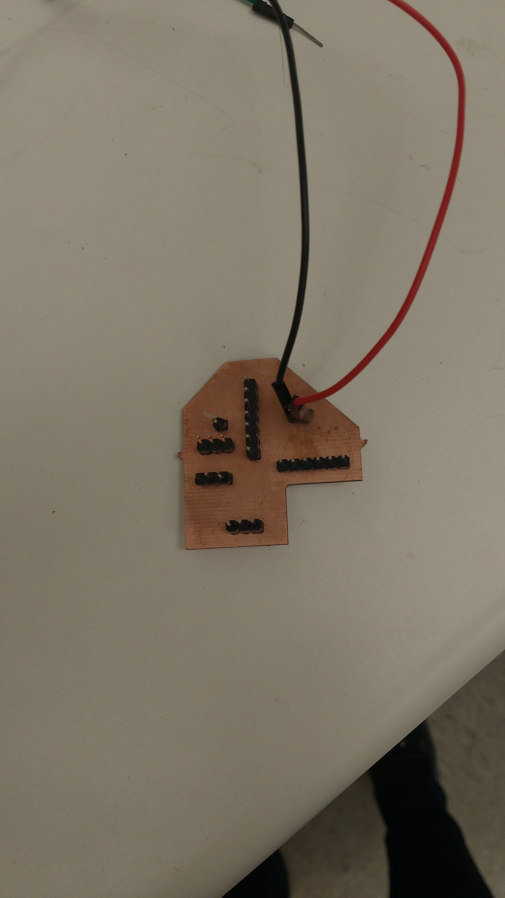
PCB Design for Container

Slide 10
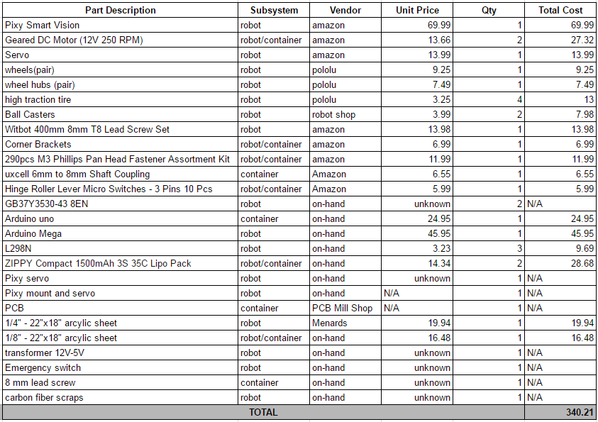
Cost BOM

Slide 11
Lessons Learned
Image sensing with Pixy is very sensitive to the surrounding lighting conditions
Tracks on PCB should be spaced out to avoid shorting during soldering
Pixy alone is unreliable for alignment with a plane, need sensors/switches
Container design could have been more robust
Used some other communication method than IR sensors

